Slide 1
Using the WiFi capabilities of the PICO W
We can set up the Pico W as a server then use it to:
Collect data from sensors attached to it and display on our browser
Send instructions from our browser to control sensor, motors attached to it
This lesson is an introduction on how we can:
Setup the Pico as a server using the network, socket library
How to get the IP address of the Pico and use our browser to connect to it
How to get the Pico’s MAC address.

Slide 2
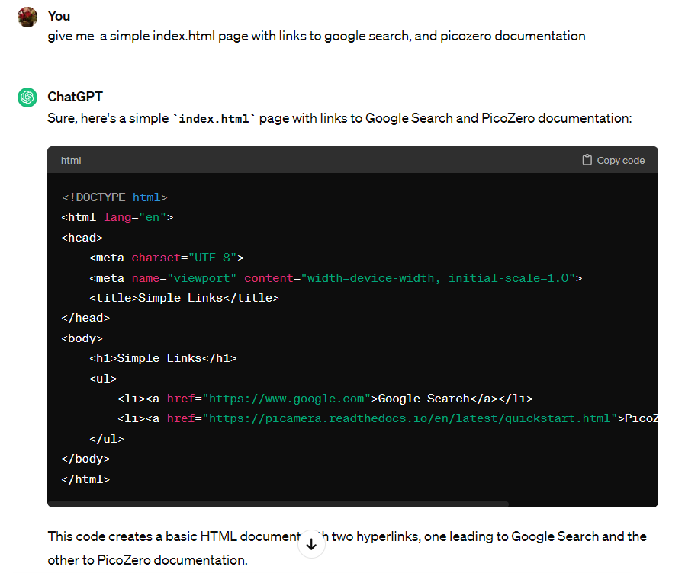
I ask ChatGPT to create a html page for me.
Then I copy and paste these codes
to my notepad and
save it as index.html

Slide 3
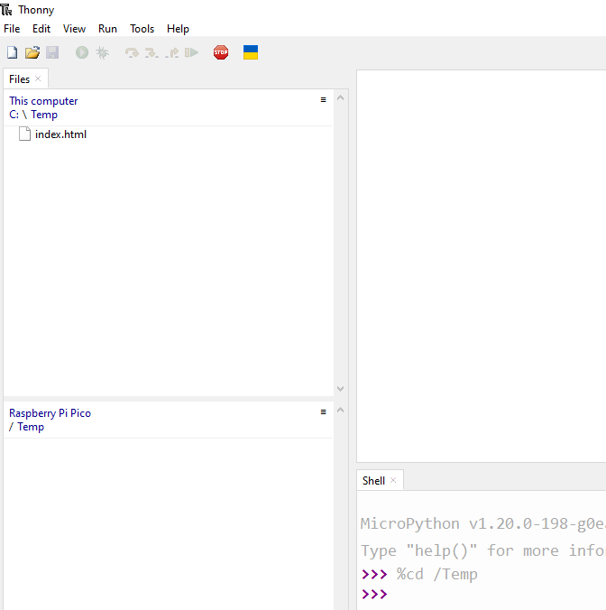
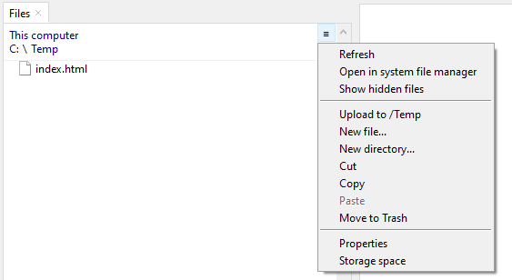
1. Create a temp folder in your C Drive and save the index.html page into it
2. Open Thonny with your Pico attached and create a Temp Directory for the Pico
3. Select index.html and Use the hamburger icon and
Upload index.html to the Pico’s /Temp Directory

Slide 4
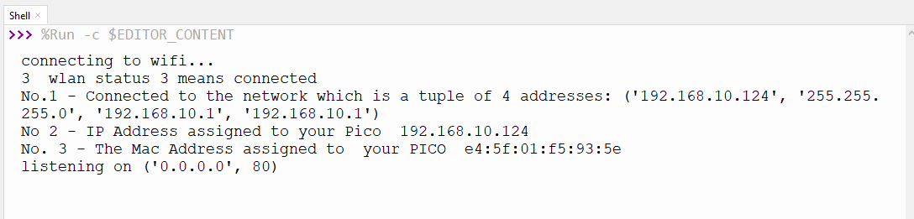
Start a new page in Thonny
Navigate to the Temp Directory where index.html is
Copy and paste wifi_lesson_1.py to it
Change to ssid and pwd to the one in your home.
Connect an LED to pin 14. This will light up when wifi connection is obtained by the Pico
Run the program and you will see this on your Thonny Shell.
This ip address will not be the same as this one.
Once you get this ip address, go to your phone or another computer
Start up the browser and type in this ip address
The Pico server will serve you index.html (see next slide)

Slide 5
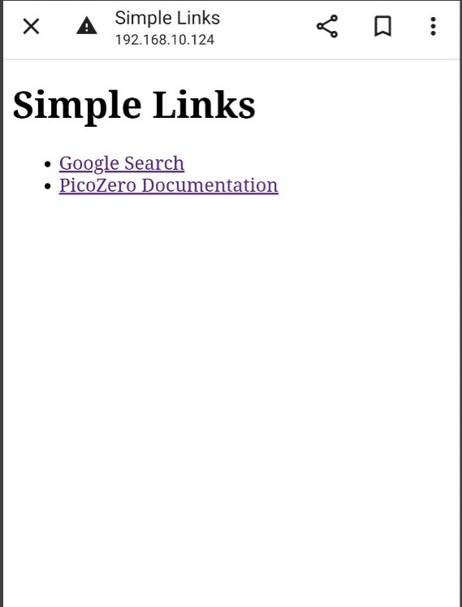
Once you see this you have
successfully set up the pico as a server.
In subsequent lesson, I will explain what
Each line of wifi_lesson_1.py means.
Following which, it there are sufficient participants interested
to pursue this further, I will show you:
How to obtain data from sensors connected to the pico server
How to send commands to the pico server to control devices
connected to it.

